Slide 1

Demystifying T1-MRI to FDG¹⁸-PET Image Translation via Representational Similarity
Chia-Hsiang Kao, Yong-Sheng Chen, Li-Fen Chen, and Wei-Chen Chiu
National Yang Ming Chiao Tung University, Taiwan
Student Travel Award in 24th International Conference on Medical Image Computing and Computer Assisted Intervention (MICCAI)
Presenter: Chia-Hsiang Kao
Supervisor: Chiu-Ming Ho, M.D., Ph.D.

Slide 2
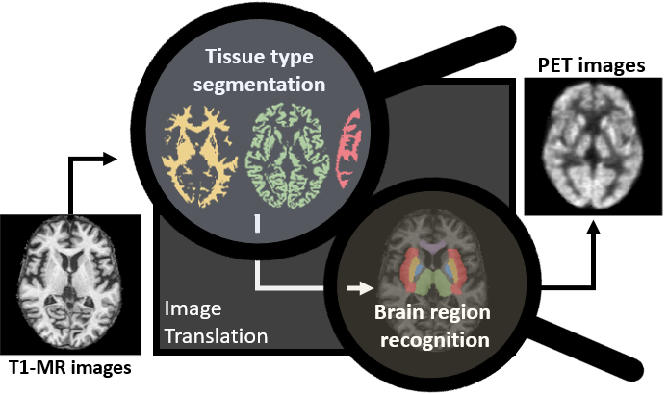
Take home message
We use representational similarity to verify our proposed hypotheses that the translation from T1-MR to PET images comprises the recognition of brain tissue types and brain regions.

Slide 3
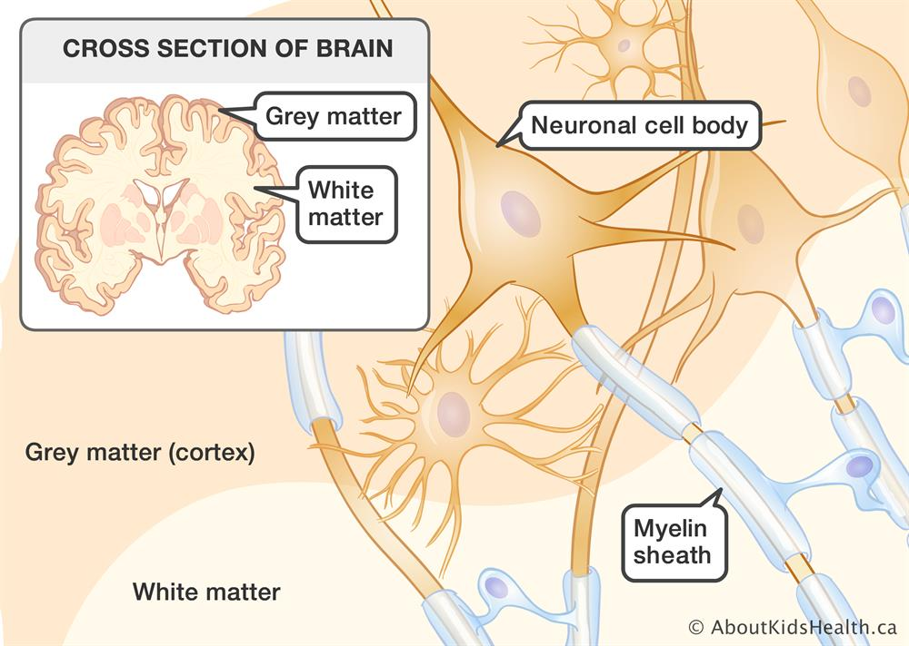
Preliminary The basic imaging principles of T1-MRI and FDG-PET.
T1-MRI | FDG-PET
Gray, because of moderate amount of water. | White, because consume much glucose to generate energy.
White, because of the lipids in the myelinated axon. | Black, because it does not contain mitochondria.

Slide 5
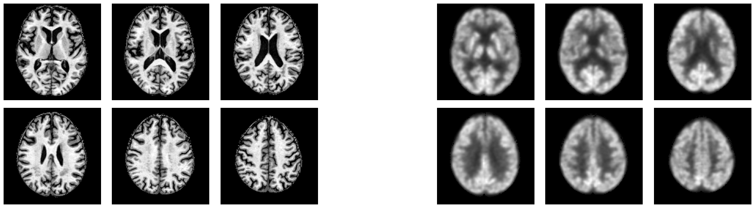
Introduction There is a growing research trend in using AI for cross-modality medical image translation.
T1-weighted Magnetic resonance imaging
(T1-MRI)
FDG¹⁸-positron emission tomography
(PET)
Principle | MRI uses strong magnetic fields to identify the anatomical structure of the brain. |  | PET measures the glucose update ability of tissue to quantify the metabolic process.
Drawback | time consuming, high cost |  | injection of radioactive tracer, high cost
DL-based image synthesis/translation
Nie, D. (2017), Pan, Y. (2018),
Sikka, A. (2018), Sun, H. (2019), Lan, H. (2020)

Slide 6
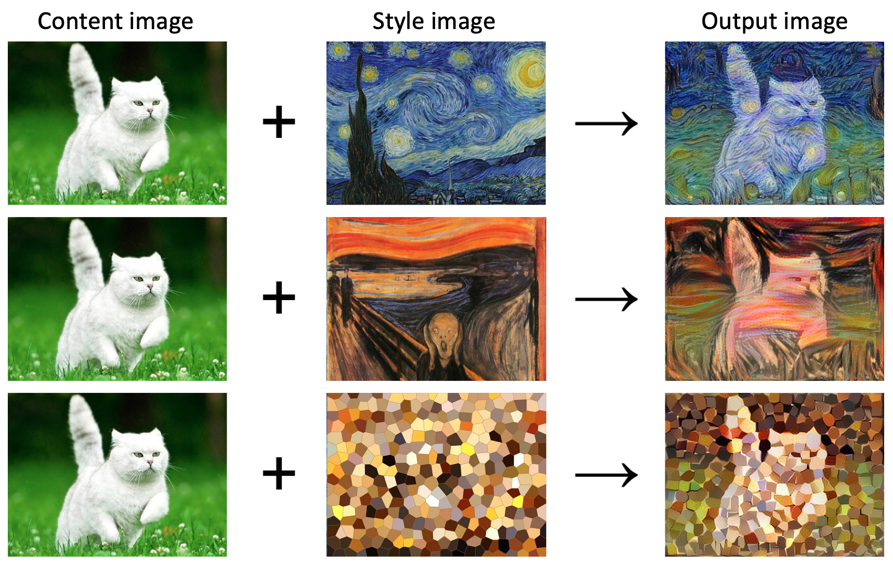
Preliminary Nowadays, we can translate images into different styles.

Slide 7
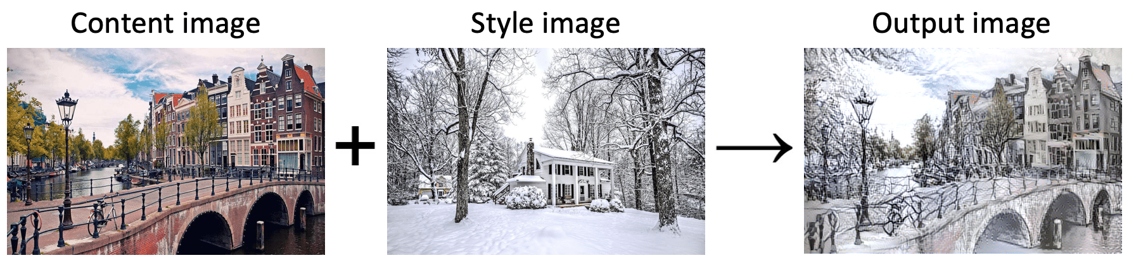
Preliminary Nowadays, we can translate images into different styles.

Slide 8
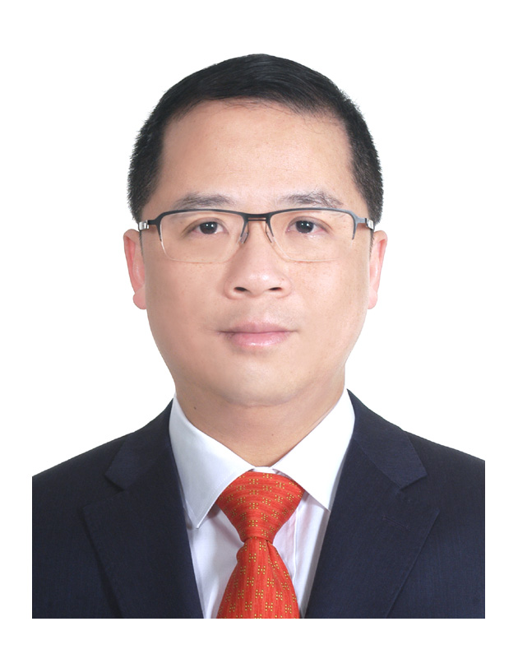
Preliminary Nowadays, we can translate images into different styles.

Slide 9
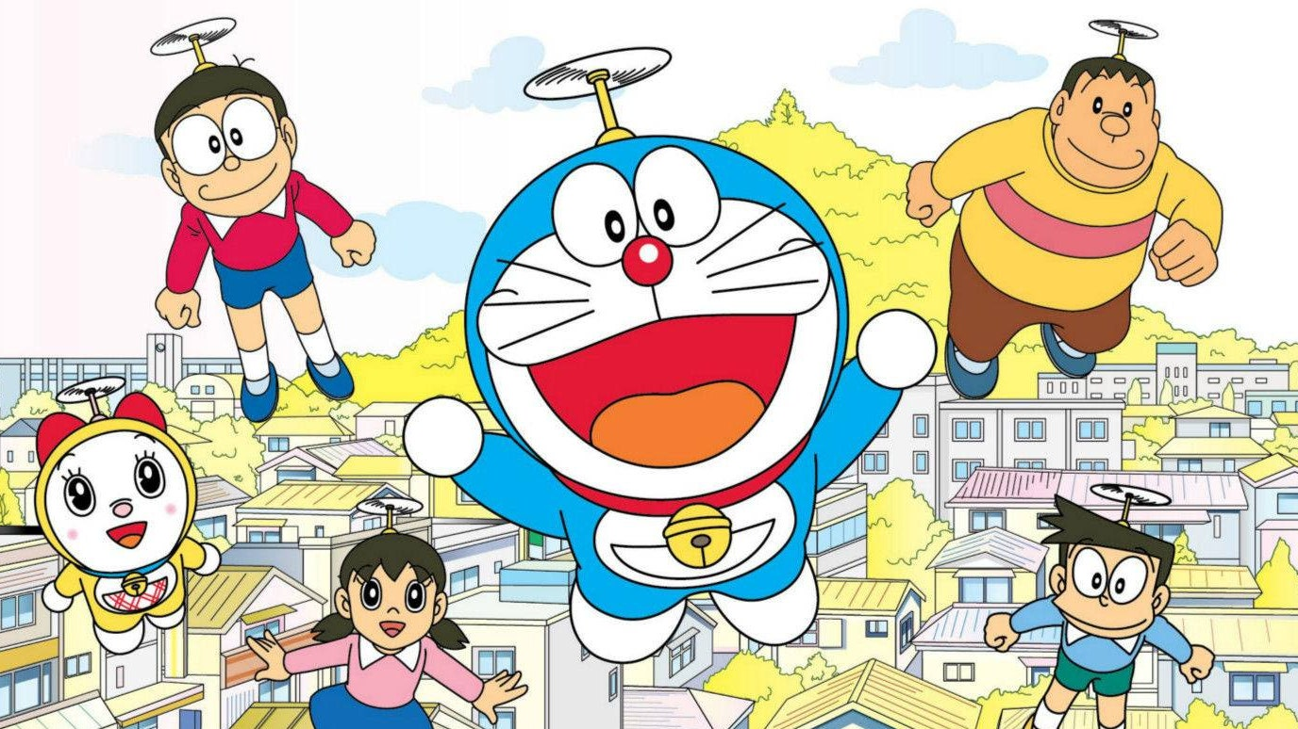
Preliminary Nowadays, we can translate images into different styles.

Slide 10
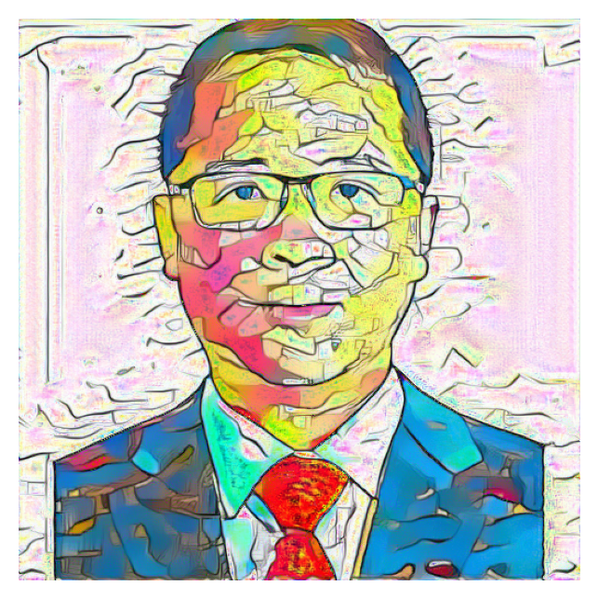
Preliminary Nowadays, we can translate images into different styles.

Slide 11
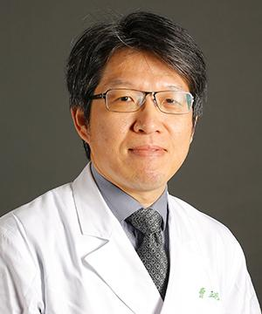
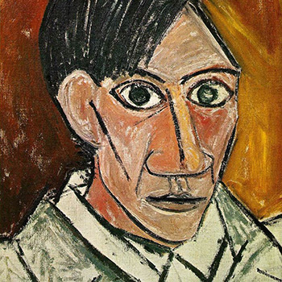
Preliminary Nowadays, we can translate images into different styles.

Slide 12
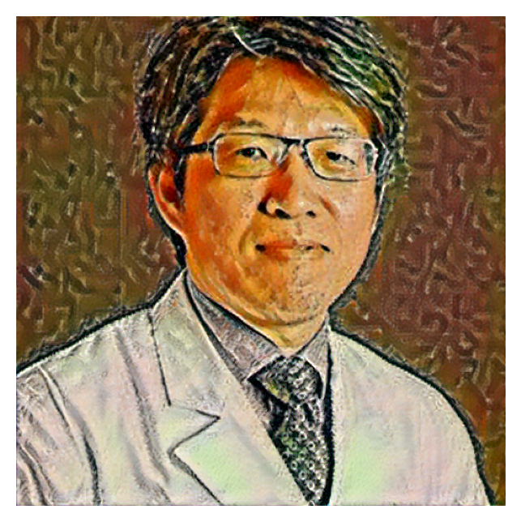
Preliminary Nowadays, we can translate images into different styles.

Slide 13
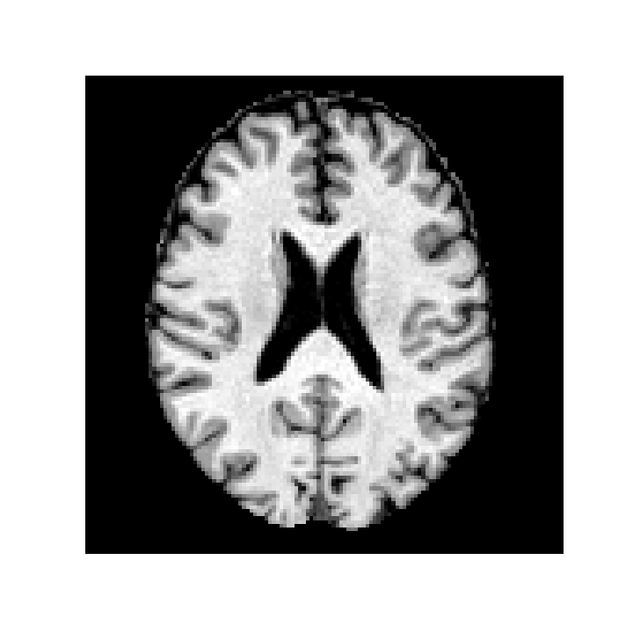
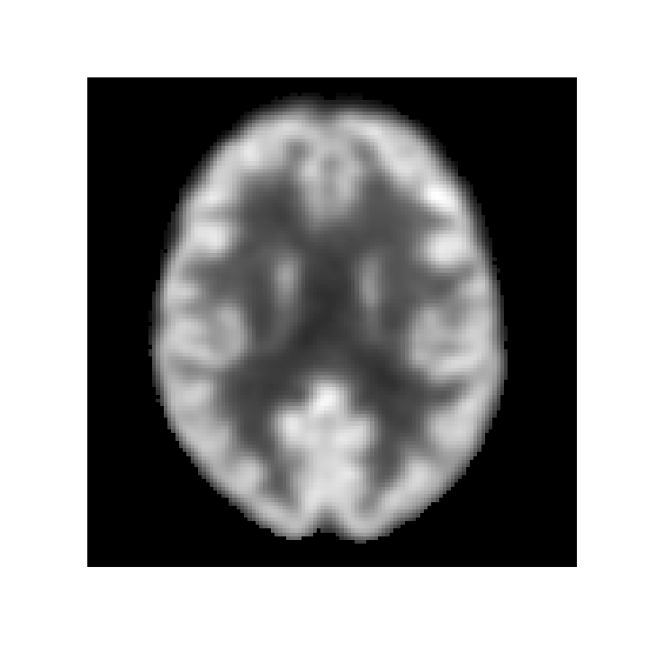
Introduction What if we can transfer T1-MRI images to FDG-PET images?
Any PET image
(to indicate the style)
T1-MRI images of a patient
T1-MRI images of a patient

Slide 14
Introduction There is a growing research trend in using AI for cross-modality medical image translation.
T1-weighted Magnetic resonance imaging
(T1-MRI)
FDG¹⁸-positron emission tomography
(PET)
Principle | MRI uses strong magnetic fields to identify the anatomical structure of the brain. |  | PET measures the glucose update ability of tissue to quantify the metabolic process.
Drawback | time consuming, high cost |  | injection of radioactive tracer, high cost
DL-based image synthesis/translation
Nie, D. (2017), Pan, Y. (2018),
Sikka, A. (2018), Sun, H. (2019), Lan, H. (2020)

Slide 15
Introduction There is a growing research trend in using AI for cross-modality medical image translation.
T1-weighted Magnetic resonance imaging
(T1-MRI)
FDG¹⁸-positron emission tomography
(PET)
Principle | MRI uses strong magnetic fields to identify the anatomical structure of the brain. |  | PET measures the glucose update ability of tissue to quantify the metabolic process.
Drawback | time consuming, high cost |  | injection of radioactive tracer, high cost
DL-based image synthesis/translation
Nie, D. (2017), Pan, Y. (2018),
Sikka, A. (2018), Sun, H. (2019), Lan, H. (2020)

Slide 16
Introduction There is a growing research trend in using AI for cross-modality medical image translation.
T1-weighted Magnetic resonance imaging
(T1-MRI)
FDG¹⁸-positron emission tomography
(PET)
Principle | MRI uses strong magnetic fields to identify the anatomical structure of the brain. |  | PET measures the glucose update ability of tissue to quantify the metabolic process.
Drawback | time consuming, high cost |  | injection of radioactive tracer, high cost
Deep learning-based image translation
Nie, D. (2017), Pan, Y. (2018),
Sikka, A. (2018), Sun, H. (2019), Lan, H. (2020)

Slide 17
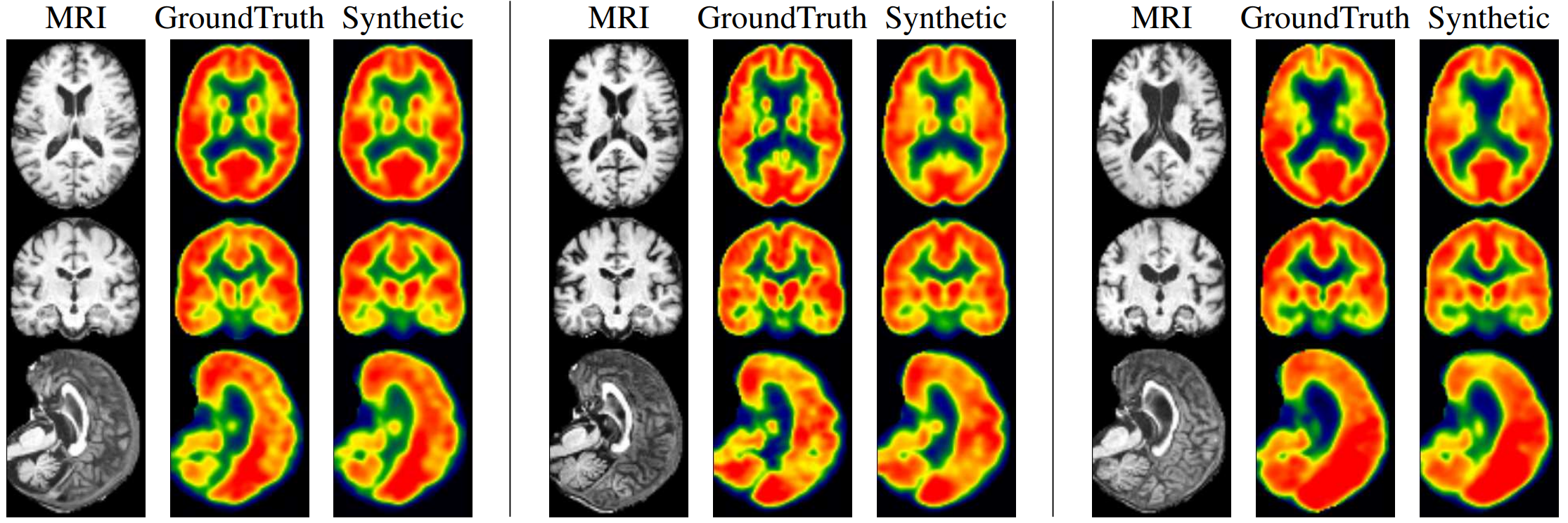
Introduction There is a growing research trend in using AI for cross-modality medical image translation.
MRI real PET Synthetic
Synthetic images are meaningful for subjects in both extremes of disease spectrum.
Left: CN. Middle: MCI. Right: AD. The generated PET images show consistency of hypometabolism (less red, more yellow) with the ground truth image.
Sun, H., Mehta, R., Zhou, H. H., Huang, Z., Johnson, S. C., Prabhakaran, V., & Singh, V. (2019). Dual-glow: Conditional flow-based generative model for modality transfer. CVPR (pp. 10611-10620).

Slide 18
Introduction There is a growing research trend in using AI for cross-modality medical image translation.
MRI real PET Synthetic
MRI real PET Synthetic
MRI real PET Synthetic
Synthetic images are meaningful for subjects in both extremes of disease spectrum.
Left: CN. Middle: MCI. Right: AD. The generated PET images show consistency of hypometabolism (less red, more yellow) with the ground truth image.
Sun, H., Mehta, R., Zhou, H. H., Huang, Z., Johnson, S. C., Prabhakaran, V., & Singh, V. (2019). Dual-glow: Conditional flow-based generative model for modality transfer. CVPR (pp. 10611-10620).

Slide 19
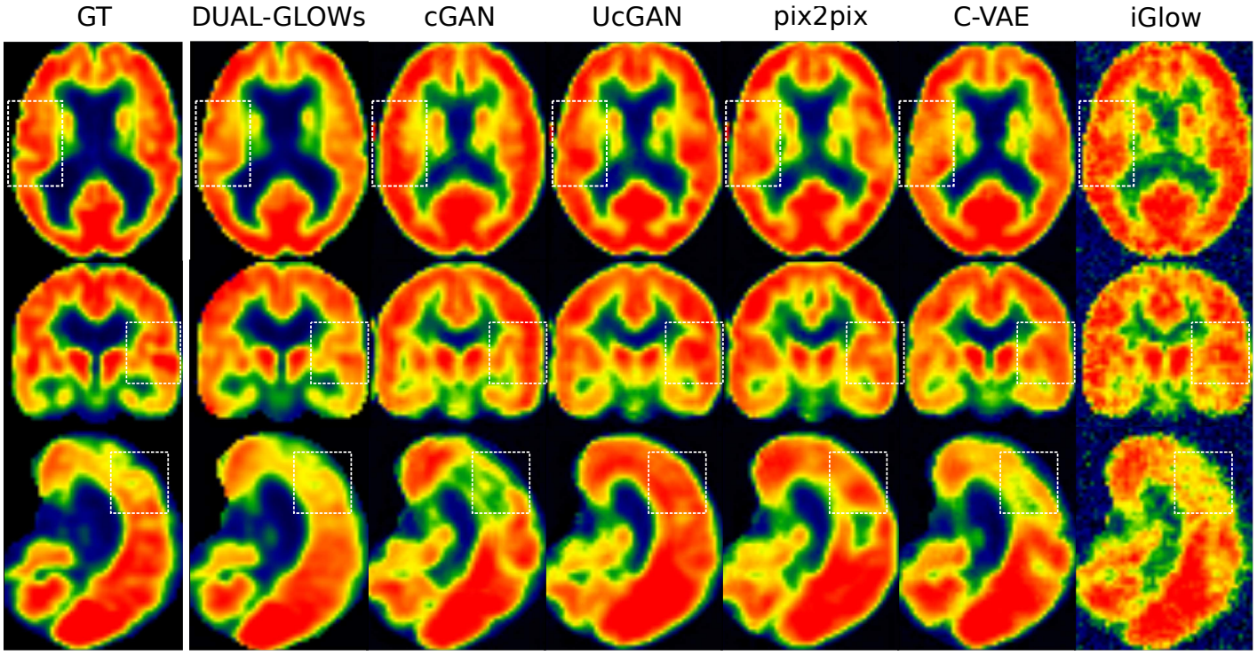
Introduction There is a growing research trend in using AI for cross-modality medical image translation.
Latest
Conventional
Sun, H., Mehta, R., Zhou, H. H., Huang, Z., Johnson, S. C., Prabhakaran, V., & Singh, V. (2019). Dual-glow: Conditional flow-based generative model for modality transfer. CVPR (pp. 10611-10620).

Slide 20
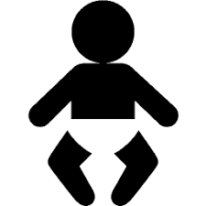

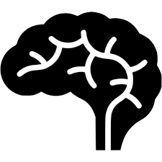
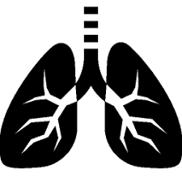



Introduction However, there are several major concerns when it comes to clinical applications.
Robustness to distributional biases (population, organs, diseases).
Robustness to systemic biases (scanning devices and protocols, preprocessing techniques).
Robustness to out-of-distribution cases, noise and adversarial perturbations.

Slide 21
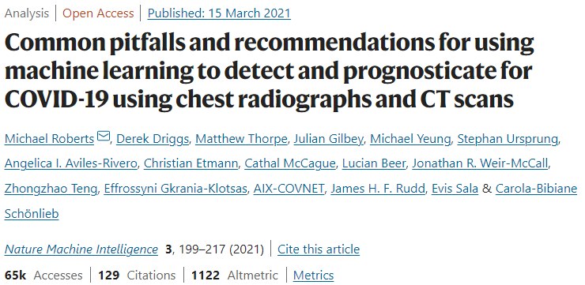
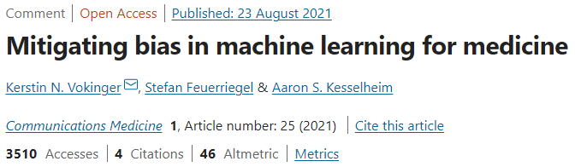
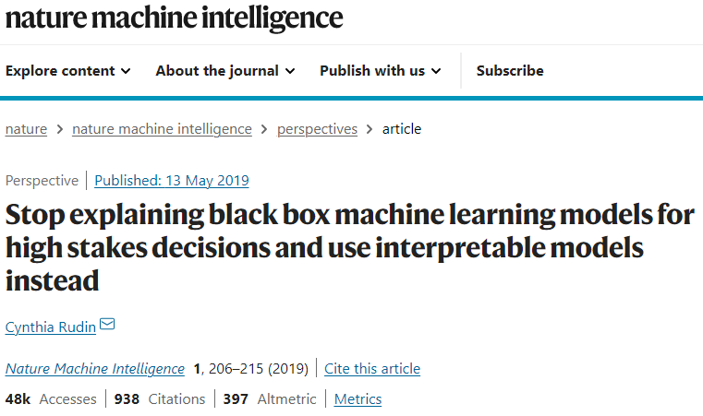
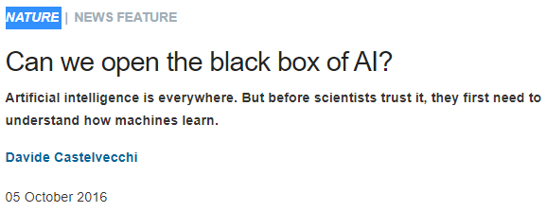
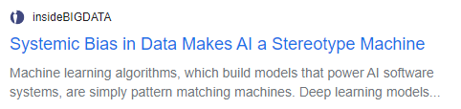
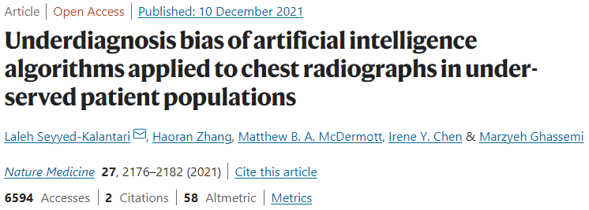
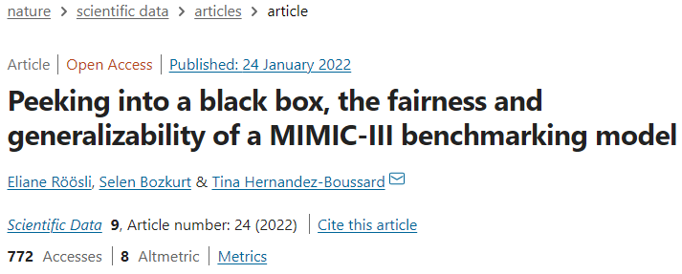
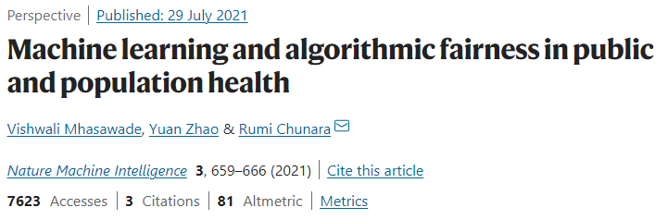
Introduction Even more, deep learning models remain black-box for most AI scientists.

Slide 22
Motivation How do deep learning models translate T1-MRI images to FDG-PET images?
?
?

Slide 23
Motivation How do deep learning models translate T1-MRI images to FDG-PET images?

Slide 24
Motivation Statement of purpose
What is known?
We can transform images of a T1-MRI style to an FDG-PET style.
What is not known?
We do not know how this transformation works.

Slide 25
Motivation Statement of purpose
What is known?
We can transform images of a T1-MRI style to an FDG-PET style.
What is not known?
We do not know how this transformation works.
Main challenge.
Deep learning models contain tens of millions of parameters. As a result, it is hard to understand the inner working mechanism of these models.
Intuition.
Does the model extract brain tissue type information during the translation process?

Slide 26

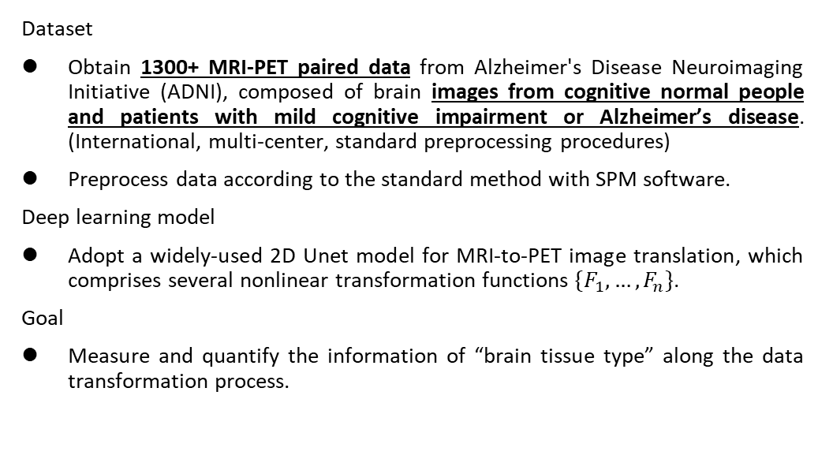
Method d
Dataset
Obtain 1300+ MRI-PET paired data from Alzheimer's Disease Neuroimaging Initiative (ADNI), composed of brain images from cognitive normal people and patients with mild cognitive impairment or Alzheimer’s disease. (International, multi-center, standard preprocessing procedures)
Preprocess data according to the standard method with SPM software.
Deep learning model
Adopt a widely-used 2D Unet model for MRI-to-PET image translation, which comprises several nonlinear transformation functions $\{F_{1},…,F_{n}\}$.
Goal
Measure and quantify the information of “brain tissue type” along the data transformation process.

Slide 27

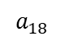
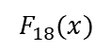
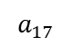
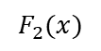
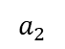
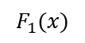
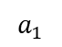
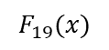
Method Deep learning model is a couple of non-linear transformation functions.
$$F_{1}(x)$$
$$F_{2}(x)$$
$$F_{18}(x)$$
$$F_{19}(x)$$
Black-box transformation process
$$a_{1}$$
$$a_{2}$$
$$a_{17}$$
$$a_{18}$$
Notes:
一個深度學習模型，本質上可以視為是許多非線性轉換的函數F的耦合

Slide 28
Method Deep learning model is a couple of non-linear transformation functions.
$$F_{1}(x)$$
$$F_{2}(x)$$
$$F_{18}(x)$$
$$F_{19}(x)$$
$$a_{1}$$
$$a_{2}$$
$$a_{17}$$
$$a_{18}$$
Notes:
一個深度學習模型，本質上可以視為是許多非線性轉換的函數F的耦合

Slide 29
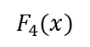
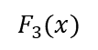
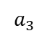
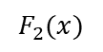
Method Compute the similarity between the intermediate (transformed) data and the GM/WM data.
$$F_{1}(x)$$
$$F_{2}(x)$$
$$F_{3}(x)$$
$$F_{4}(x)$$
$$a_{1}$$
$$a_{2}$$
$$a_{3}$$

Slide 30
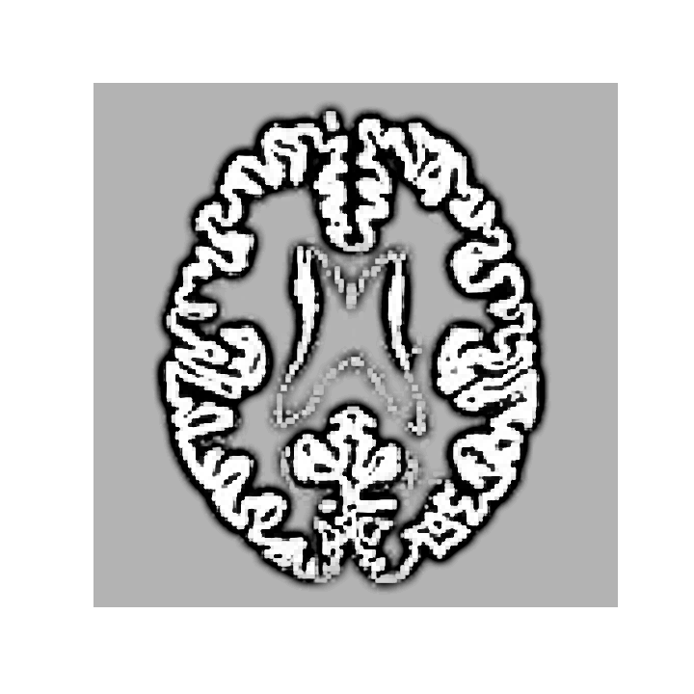
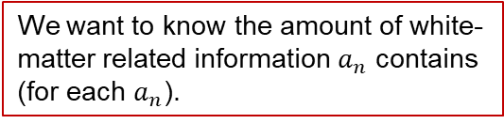
Method Compute the similarity between the intermediate (transformed) data and the GM/WM data.
$$F_{1}(x)$$
$$F_{2}(x)$$
$$F_{3}(x)$$
$$F_{4}(x)$$
$$a_{1}$$
$$a_{2}$$
$$a_{3}$$
We want to know the amount of white-matter related information $a_{n}$ contains (for each $a_{n}$).

Slide 31
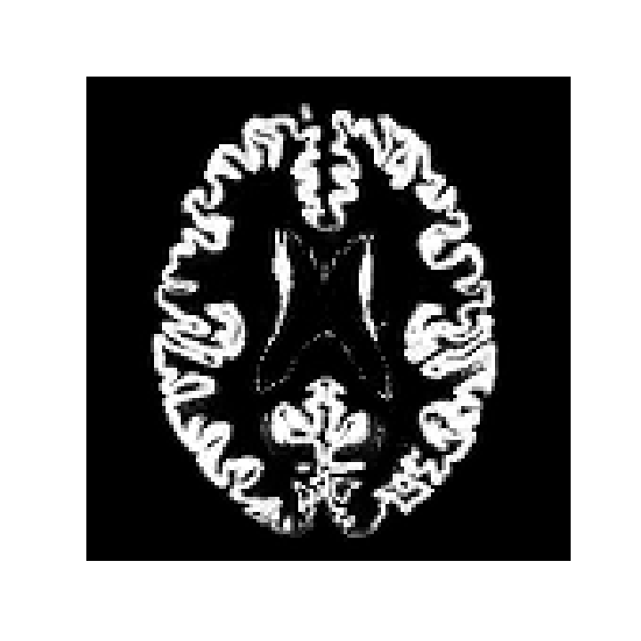
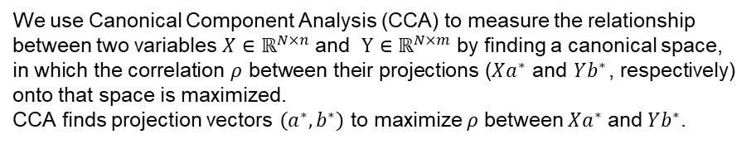
Method Compute the similarity between the intermediate (transformed) data and the GM/WM data.
$$F_{1}(x)$$
$$F_{2}(x)$$
$$F_{3}(x)$$
$$F_{4}(x)$$
$$a_{1}$$
$$a_{2}$$
$$a_{3}$$
15%
19%
65%
We use Canonical Component Analysis (CCA) to measure the relationship between two variables $X∈ℝ^{N×n}$ and $Y∈ℝ^{N×m}$ by finding a canonical space, in which the correlation $ρ$ between their projections ($Xa^{∗}$ and $Yb^{∗}$, respectively) onto that space is maximized.
CCA finds projection vectors $\left(a^{∗},b^{∗}\right)$ to maximize $ρ$ between $Xa^{∗}$ and $Yb^{∗}$.
How to interpret the meaning of CCA similarity?

Slide 32
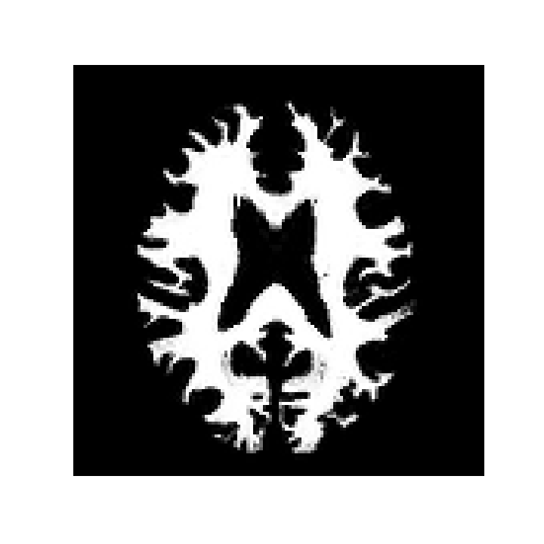
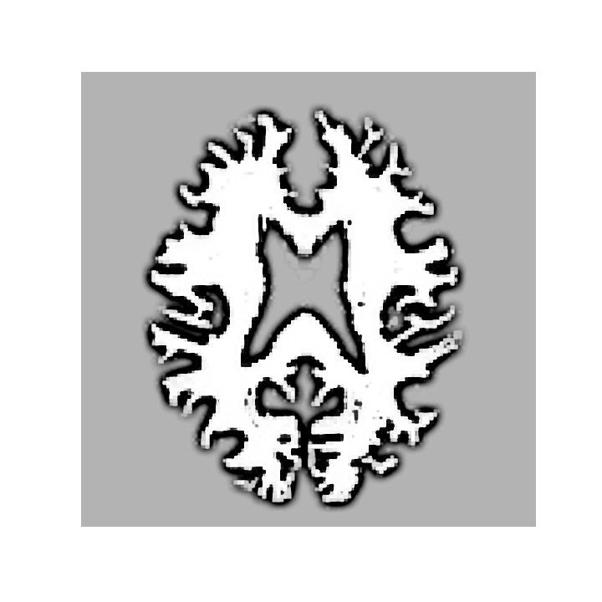
Method Compute the similarity between the intermediate (transformed) data and the GM/WM data.
$$F_{1}(x)$$
$$F_{2}(x)$$
$$F_{3}(x)$$
$$F_{4}(x)$$
$$a_{1}$$
$$a_{2}$$
$$a_{3}$$
15%
19%
65%
85%
89%
85%

Slide 33
Method Compute the similarity between the intermediate (transformed) data and the GM/WM data.
$$F_{1}(x)$$
$$F_{2}(x)$$
$$F_{3}(x)$$
$$F_{4}(x)$$
$$a_{1}$$
$$a_{2}$$
$$a_{3}$$
15%
19%
65%
85%
89%
85%
10%
50%
90%

Slide 34
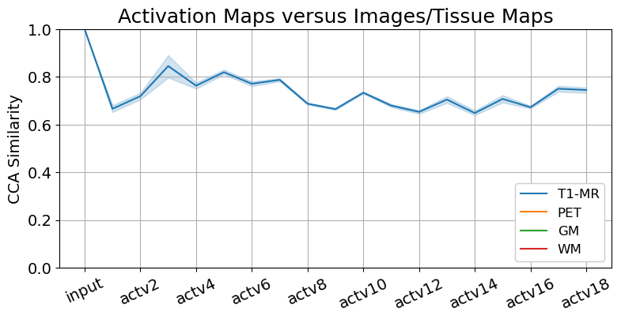
Results Brain tissues are segmented in the early encoding stage of image translation.

Slide 35
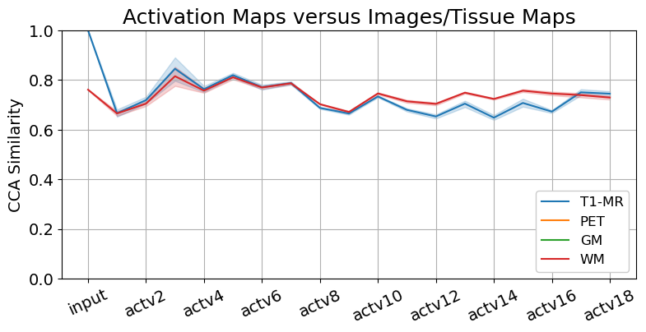
Results Brain tissues are segmented in the early encoding stage of image translation.

Slide 36
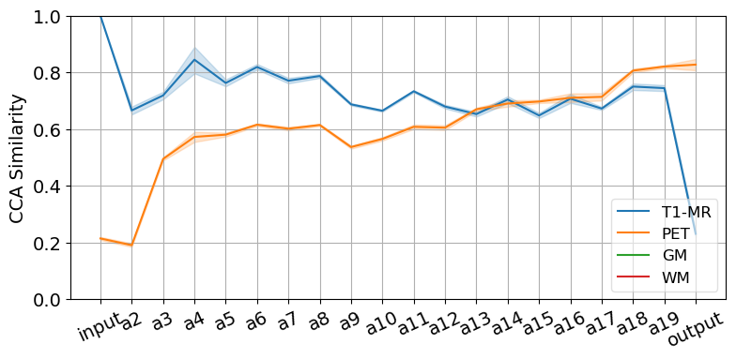
Results Brain tissues are segmented in the early encoding stage of image translation.
…
Notes:
橫軸是18 個非線性轉換函數
縱軸是計算出的similarity

Slide 37
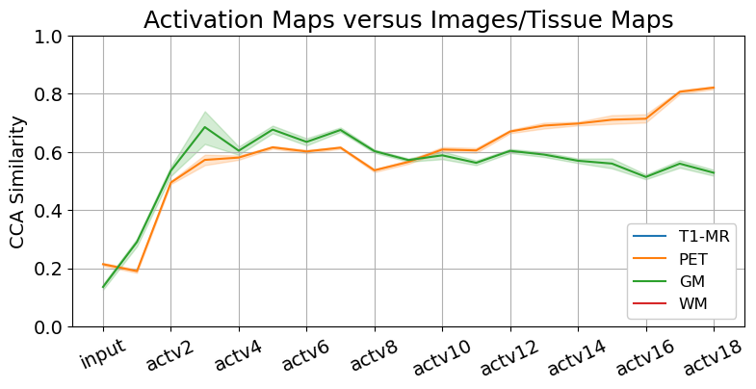
Results Brain tissues are segmented in the early encoding stage of image translation.
Notes:
橫軸是18 個非線性轉換函數
縱軸是計算出的similarity

Slide 38
Results Brain tissues are segmented in the early encoding stage of image translation.
Notes:
橫軸是18 個非線性轉換函數
縱軸是計算出的similarity

Slide 39
Results Brain tissues are segmented in the early encoding stage of image translation.
要分多開

Slide 40
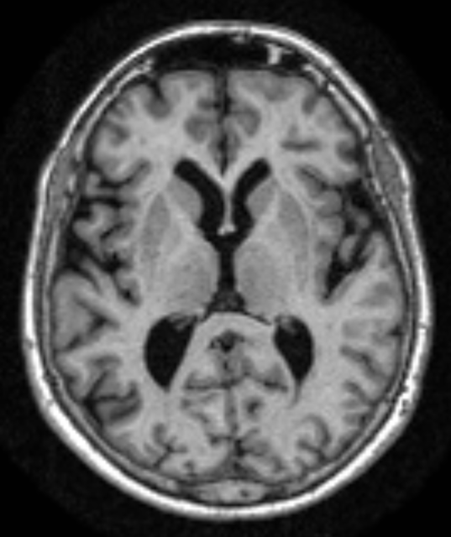

Hypothesis Deep learning models learn to segment brain regions.
Higher uptake regions in NC
Least altered regions during aging
Regions of hypometabolism in AD
Brain: normal variations and benign findings in fluorodeoxyglucose-PET/computed tomography imaging. (PET Clin. 2014)
Voxel-based mapping of brain gray matter volume and glucose metabolism profiles in normal aging. (Neurobiology of Aging. 2007)
Brain PET in the diagnosis of Alzheimer's disease. (Clin Nucl Med. 2014)

Slide 41





Results Brain regions are identified in the decoding stage of translation.
下面的函數在幹嘛
$$F_{1}(x)$$
$$F_{2}(x)$$
$$F_{3}(x)$$
$$F_{4}(x)$$

Slide 42
Take home message
We use representational similarity to verify our proposed hypotheses that the translation from T1-MR to PET images comprises the recognition of brain tissue types and the identification of brain regions.

Slide 43
Limitation ff
Dataset – organs, diseases, modalities (e.g., different radioactive tracers), machines.
Models – various deep learning models.
Measurement of similarity – curse of dimensionality.

